Slide 1

Unsupervised Learning for Clustering and Recommendation system on insurance dataset
Baginda Ichwan Syahputra

Slide 2
About the dataset
Product Information
ID & Customer ID
Insurance Type
Policy Duration
Policy Type
Policy Category
Premium Amount
Response
Customer Information
City Code
Region Code
Accomodation Ownership
Age at Entry
Marital Status
Indicate the ID of each customer
Individual & Joint
Duration policy since it issued
Type of product
Category of product
Premium that policy holder should pay
Target variable
The city where the policy holder live
The region in the city where the policy holder live
Home ownership status
Age at policy holder buy the police
Married or single

Slide 3



Data Preprocessing
Replacing The Null and NaN values with features statistic (mean, median, mode).
Removing the Outlier that outside the minimal and maximal quantile (Prem Amnt)
Doing the encoding for some object data type because the algorithm can only process the numerical values
Simplify the multiple type of data that has same meaning (Ins Type)
Dropping some unncecessary features and do the standardization on all numerical data so the clustering algorithm performance can be maximized

Slide 4

Recommendation System

Slide 5
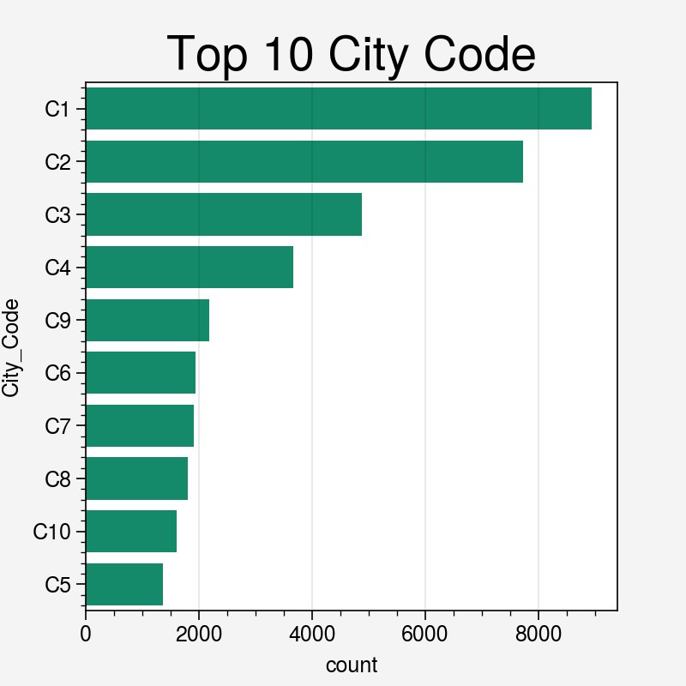
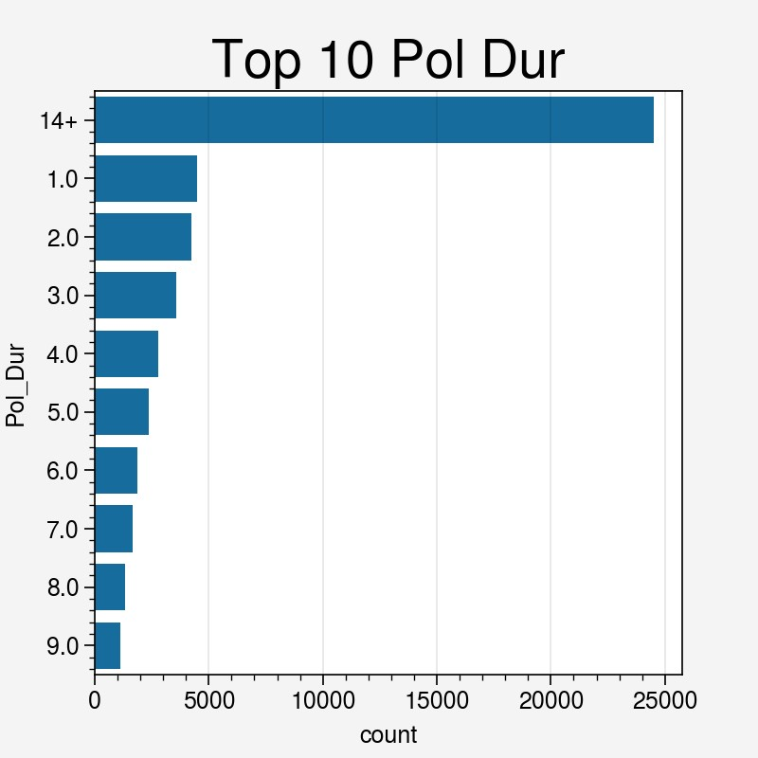
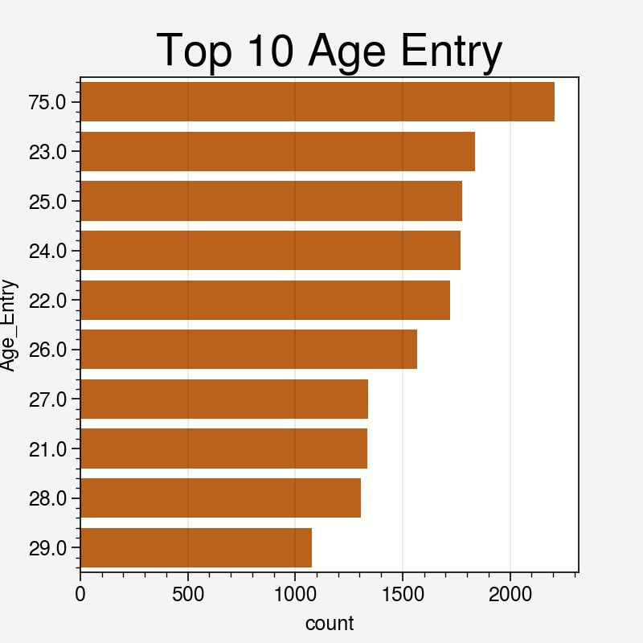
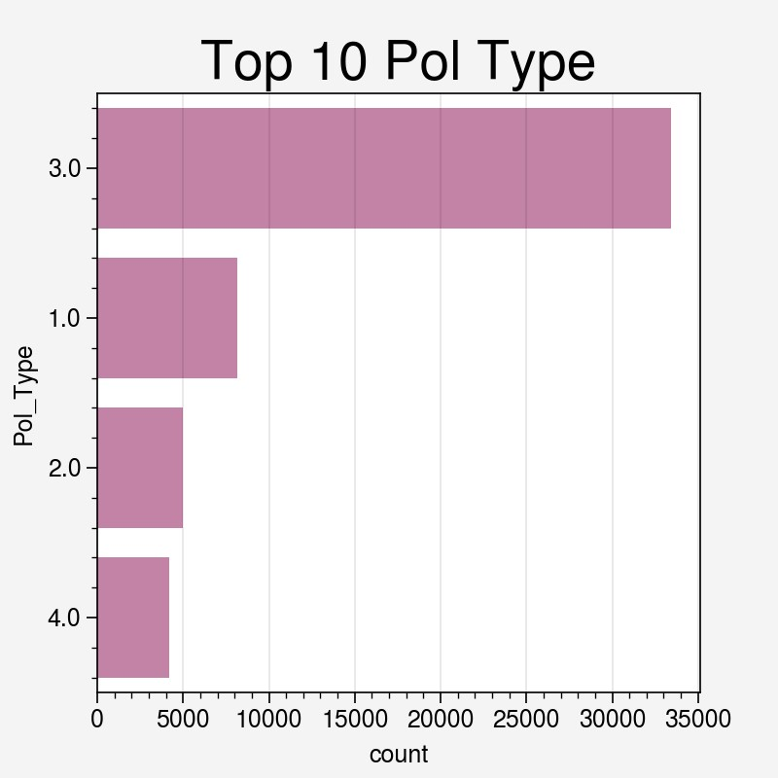
DATA TREND

Slide 6
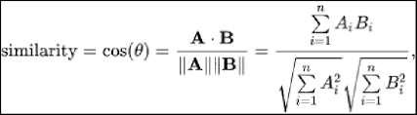
COSINE SIMILARITY

Slide 7
RECOMMENDATION ENGINE
Input
(Custmer Info):
City
Accom Own
Modeling (Cosine Similarity)
Convert input into vector
Cosine Similairty dot products
Output
(Insurance Info):
Policy Duration
Age
Marital Stat
Sorting
Policy Type
Policy Category
Premium Amount

Slide 8
Clustering

Slide 9
Clustering Algorithm
our
K – Nearest Neighbour
The algorithm learn from the past experience (supervised)
Classification and Regression problem
Require label
K – Means
The algorithm doest learn from the past experience (unsupervised)
Clustering (segmentation) Analysis and Data mining
No label required

Slide 10
K-Means Modeling

Slide 11
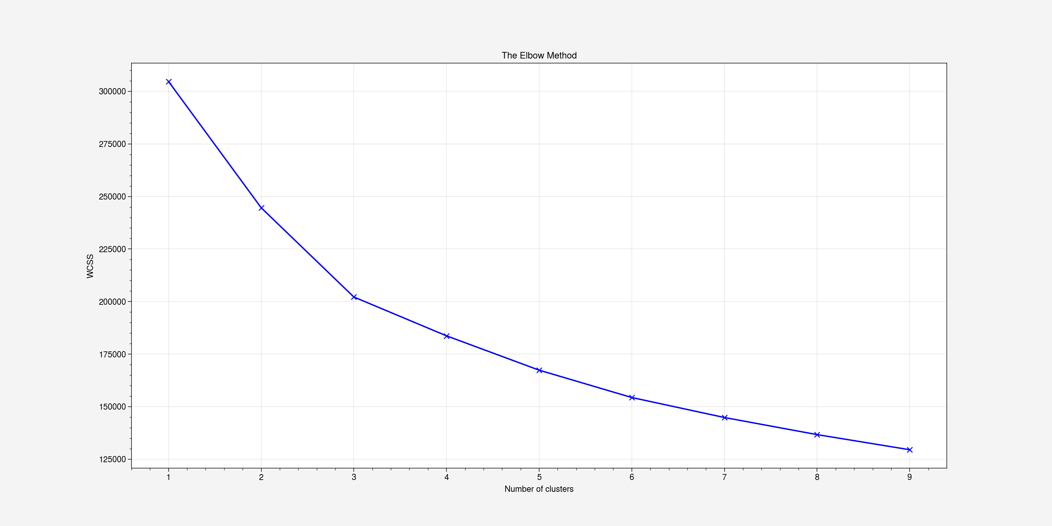
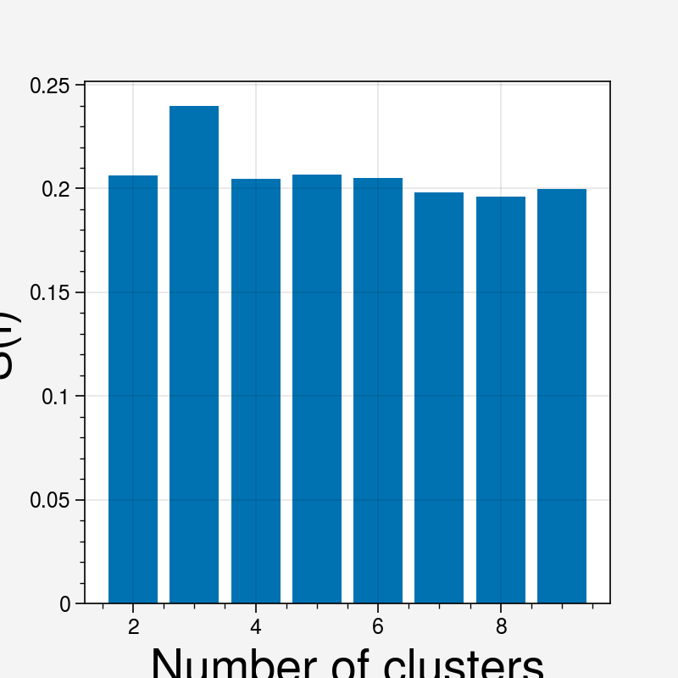
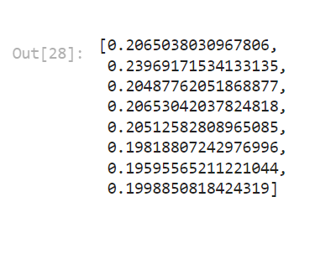
Elbow method and silhouette score

Slide 12
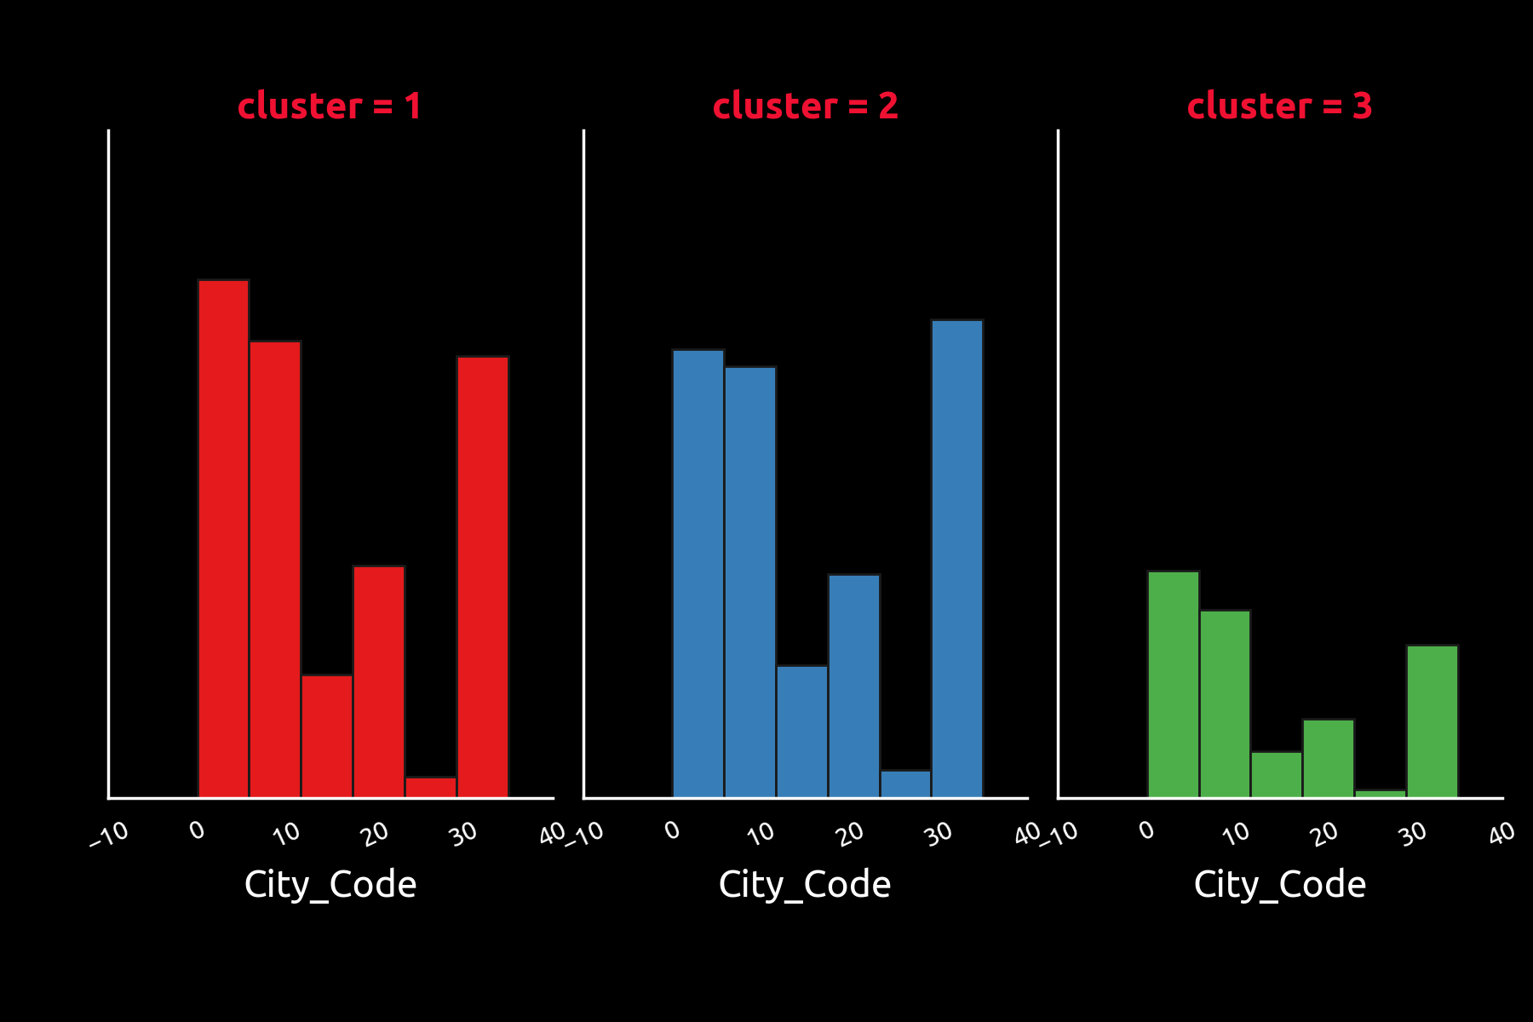
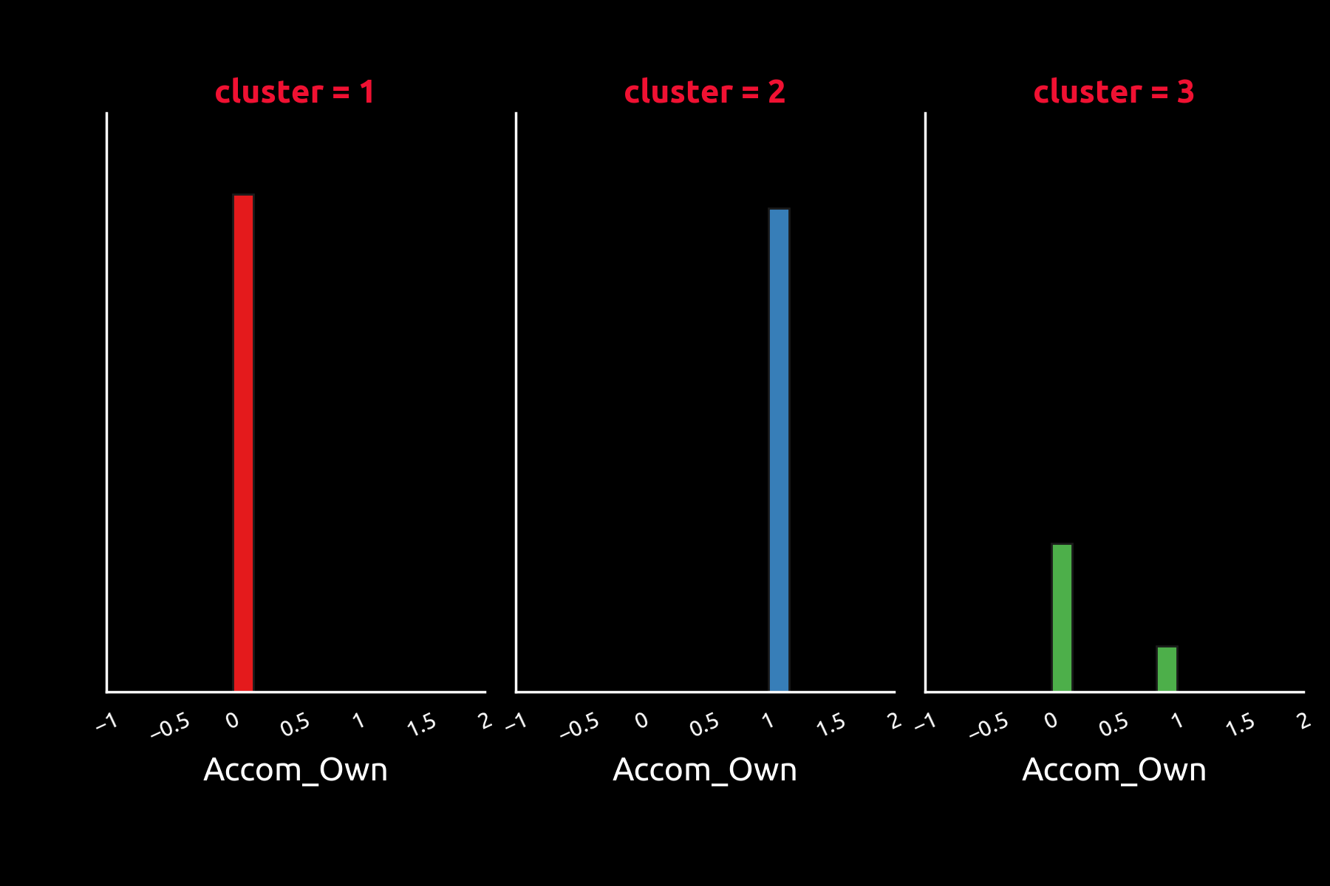
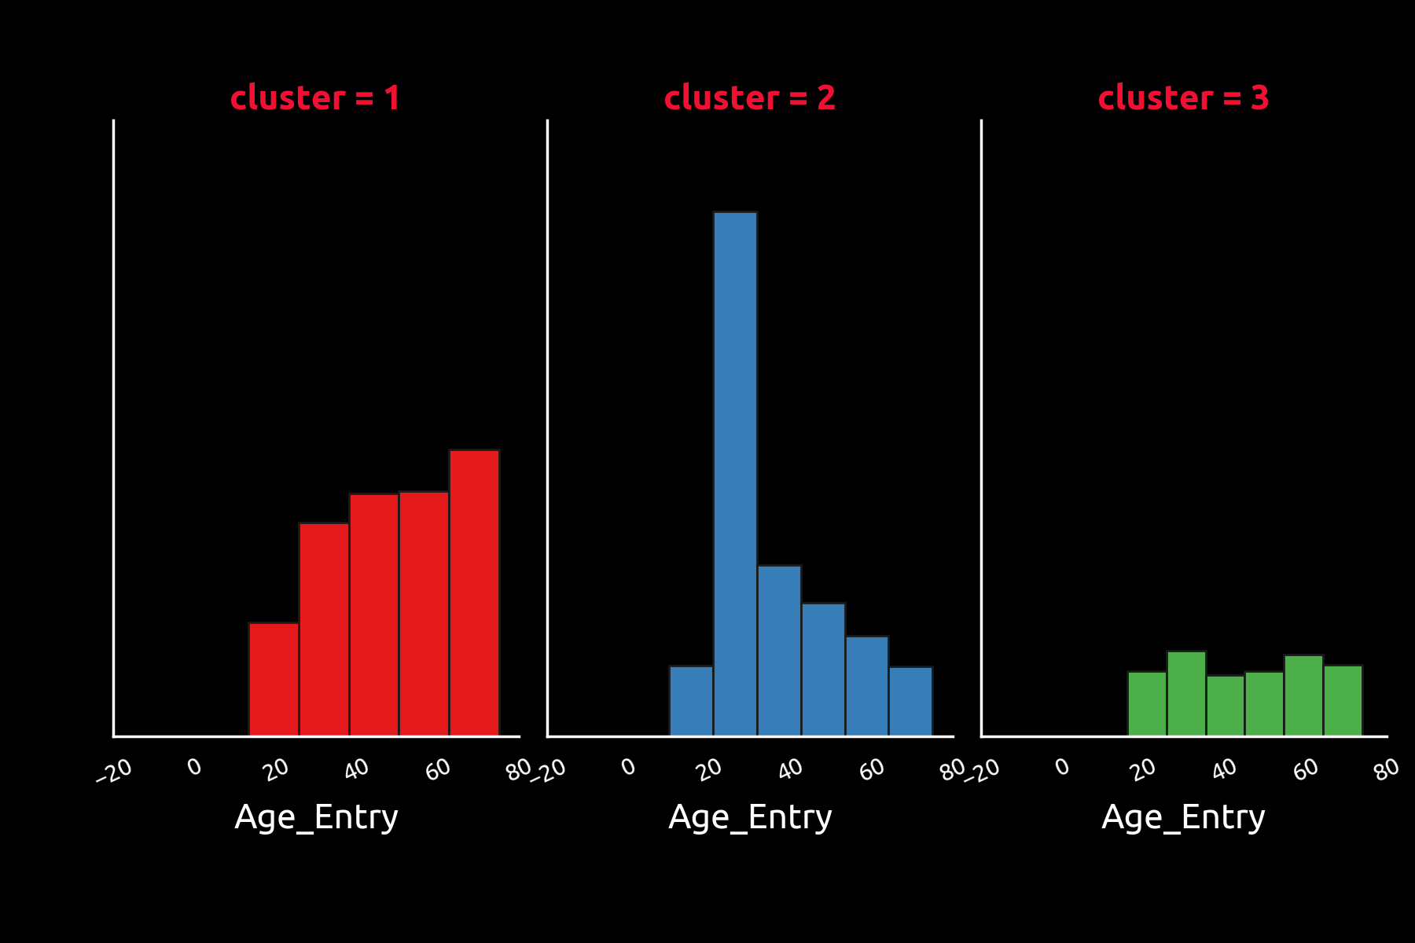
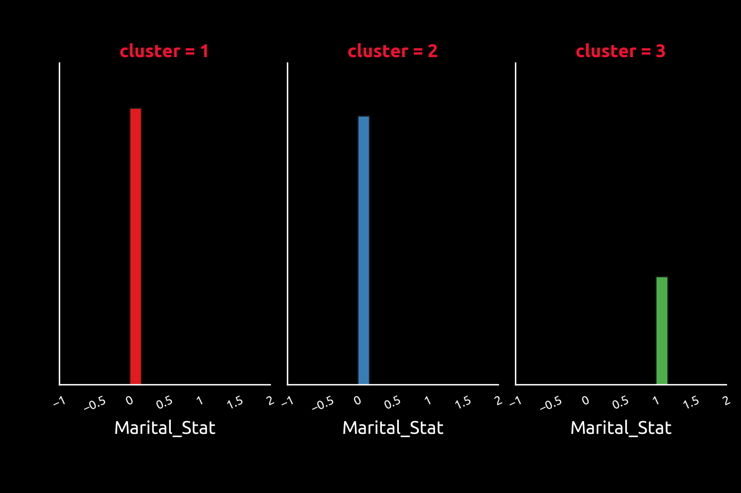
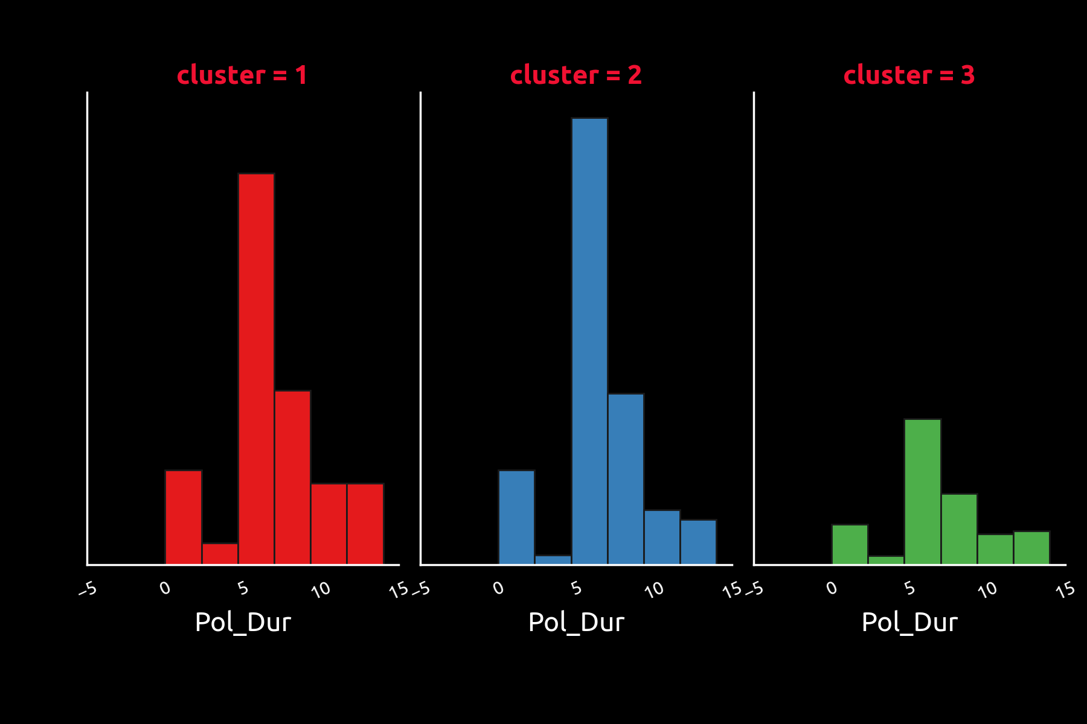
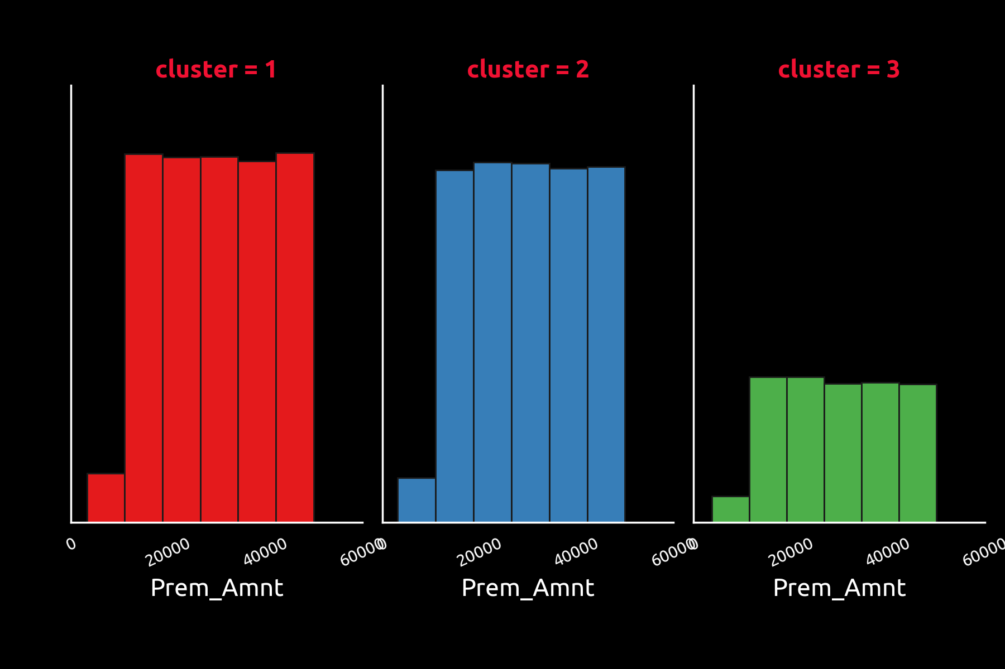
Segmentation Analysis

Slide 13
Segmentation Analysis
Cluster 1
Cluster 2
Cluster 3
Least recommended customer
Age
Dominated by old age (40 yo – 80 yo)
Accom Own
Own house
City Code
Mostly live in biggest city
Marital Status
Single
Policy Duration
Mostly inforced over year 14+
Premium
Average volume on 20k-40k premium
Highly recommended customer
Age
Dominated by productive age (20 yo – 40 yo)
Accom Own
Rented house
City Code
Mostly live in second or third biggest city
Marital Status
Single
Policy Duration
Mostly inforced over year 14+
Premium
Average volume on 20k-40k premium
Moderate recommended customer
Age
Variated age (20 yo – 80 yo)
Accom Own
Most of them own house
City Code
Mostly live in biggest city
Marital Status
Married
Policy Duration
Mostly inforced over year 14+
Premium
Average volume on 20k-40k premium

Slide 14
Strength and Weakness
Cluster 1
Cluster 2
Cluster 3
Strength :
Mostly have stable income (from owning the house/flat)
Weakness :
Most of them are old. The risk in this cluster to claim the benefit soon is quite high.
Most of them are single.
Strength :
On very productive age
Have a good income (purchasing insurance and live in big city)
Single
Weakness :
Most of them not owning house/flat
Strength :
Owning House/Flat
Have a good income
Have a family
Weakness :
The population of this cluster is very small
Some old people that not owning the house is quite risky.

Slide 15
Insight for the insurance company
Cluster 1
Cluster 2
Cluster 3
The risky part of this cluster is they are mostly old and single. Even though they are quite stable in term of income, but at the same condition they are very risky to get sick or even death. The insurance company (underwriter) should focus on reviewing YRT (Yearly Renewable term) policies, whether it should be renewed or not.
This cluster also still has some policy holder from productive age. The insurance company also should maintain and targeting this segment also because they has a better income than youngsters in cluster 2 (they owned the house)
This cluster has the biggest potential among other clusters. There are young, has good income, and single. Insurance company can sell them many products like medical protection, pension fund + protection, education insurance, and many more.
To maintain the policy holder that has long term insurance from this cluster, insurance company should give them credit like loyalty bonus or discounted premium for certain policy duration
Most of peoples in this cluster are newly wed, lot of potential that insurance company can get from this cluster especially once they have a kid. Education plan insurance and Family care insurance are the two main products that insurance company should consider to target this cluster.
The insurance company can also offer the general insurance like fire insurance because this cluster mostly own the house.

Slide 16


